Slide 1

A Tool for Lecture Assessment as per OBE policy
DEPARTMENT OF COMPUTER SCIENCE
Team Members-
Pallavi Sharma (2200290120116)
Saksham (2200290120143)

Slide 2
Problem Statement
In Outcome-Based Education (OBE) environments, measuring student engagement and understanding after each lecture is crucial. Traditional methods, such as oral questioning, often result in limited student participation and fail to provide comprehensive insights into learning outcomes. There is an urgent need for an automated solution to evaluate student understanding after lectures, in real time.

Slide 3
Project Objective
To design and implement a cost-effective, distraction-free hardware-software system that enhances student engagement and accurately measures learning outcomes in classrooms by enabling real-time participation through MCQ-based assessments, without relying on traditional computing infrastructure or mobile devices.

Slide 4

SDG Mapping
SDG 4 – Quality Education
Improves classroom engagement.
Helps teachers track learning outcomes (OBE-based).
Provides a distraction-free answering system.
Supports real-time assessment of MCQs.
Enhances teaching effectiveness through technology.

Slide 5
Introduction
Active student participation is vital for achieving lecture objectives.
Traditional methods, like asking questions to selected students, may not accurately reflect overall student understanding.
To solve this, an innovative hardware-software system is introduced to enhance classroom assessments and engagement.
The system includes a compact, user-friendly hardware device that enables students to answer MCQs during lectures.
It replaces mobile phones, reducing distractions from notifications and social media.
The device ensures equal access to technology for all students.
The software records responses, offers real-time feedback, and provides analytics for teachers.
This integration helps educators identify learning gaps, adjust teaching methods, and effectively track student progress.

Slide 6


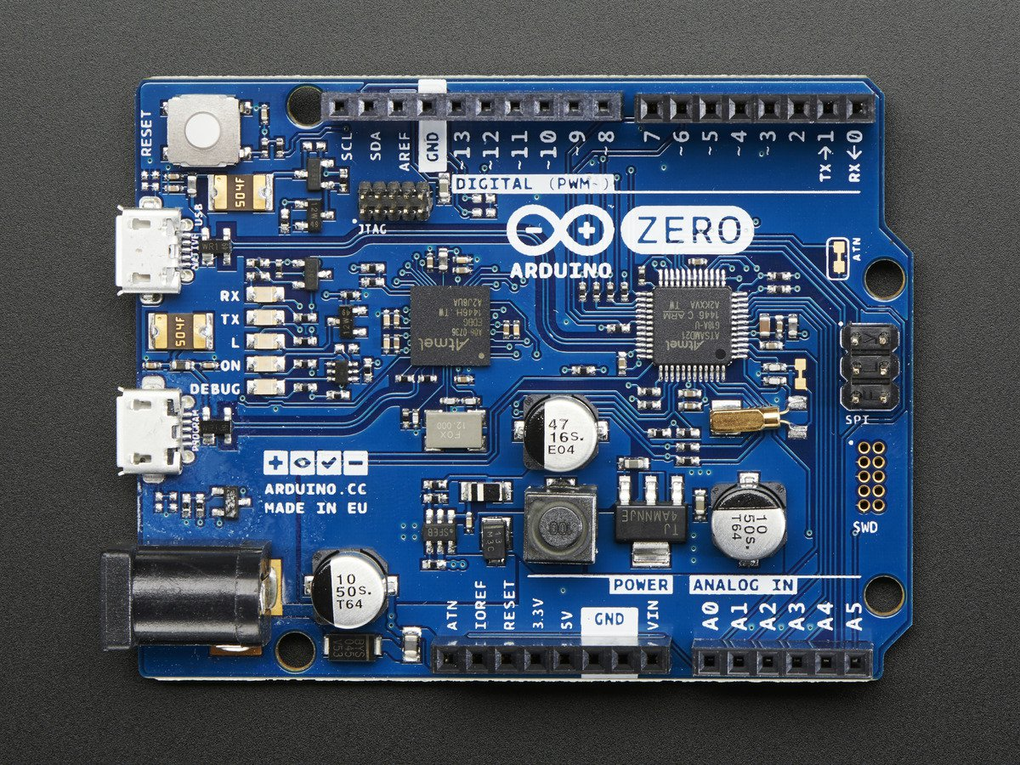
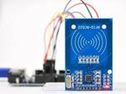
Technology Used
Frontend
React.js
Backend
Node.js
IOT
RFID
Arduino

Slide 7
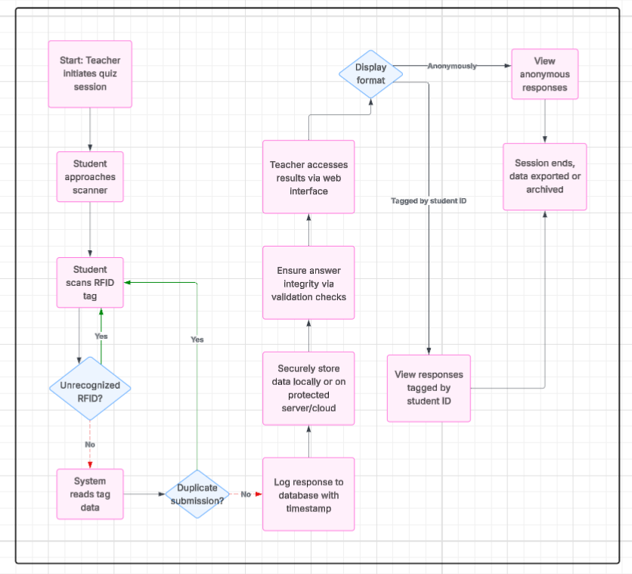
Flowchart

Slide 8
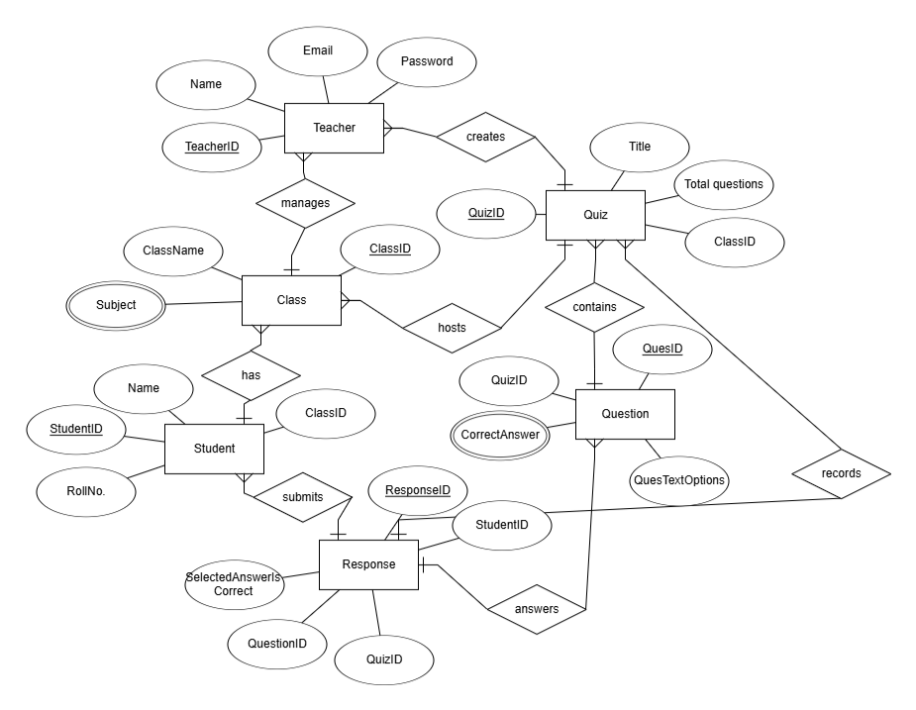
ER Diagram

Slide 9
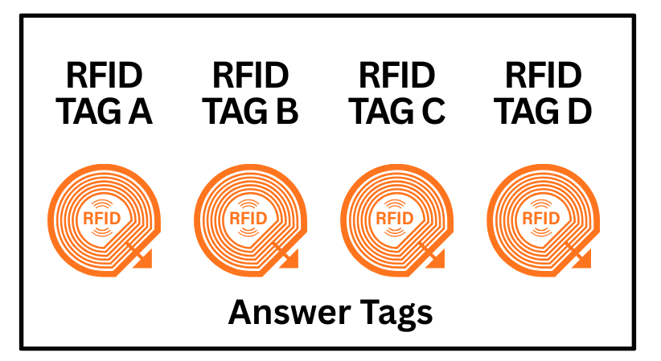
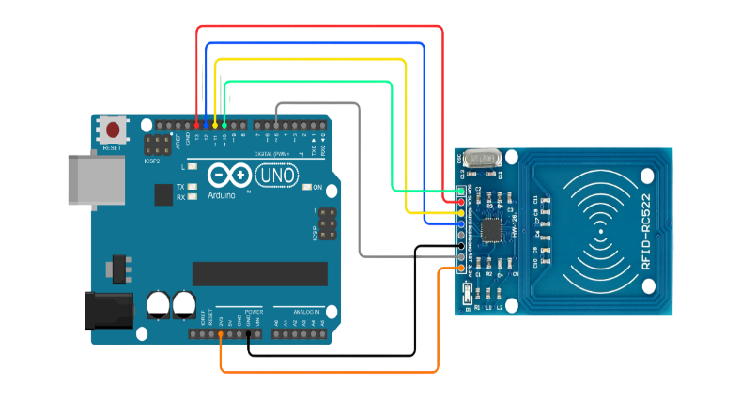
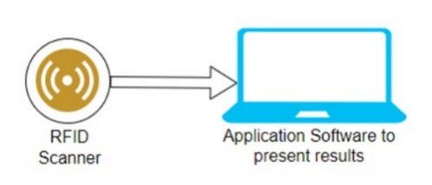
Project Prototype

Slide 10
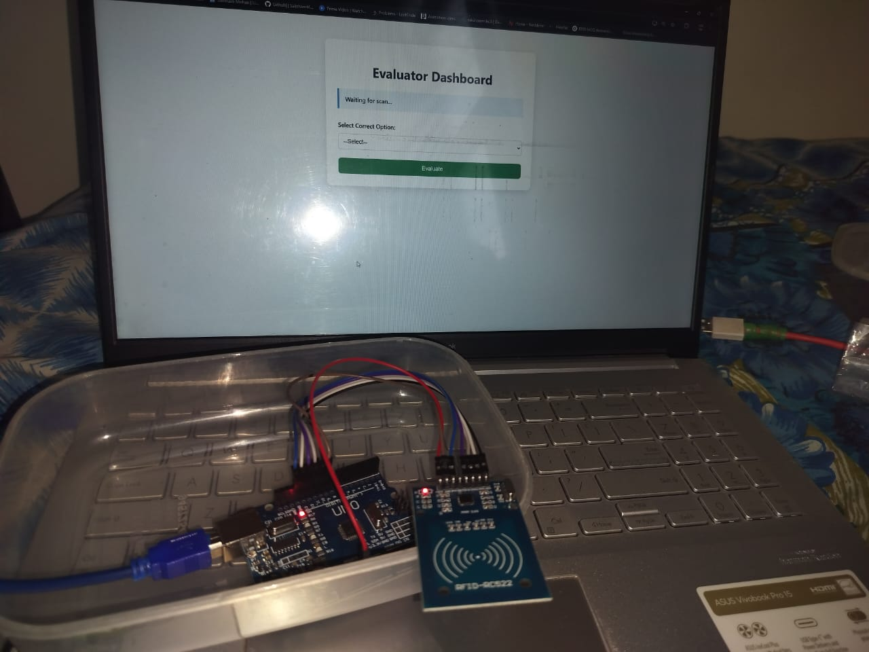
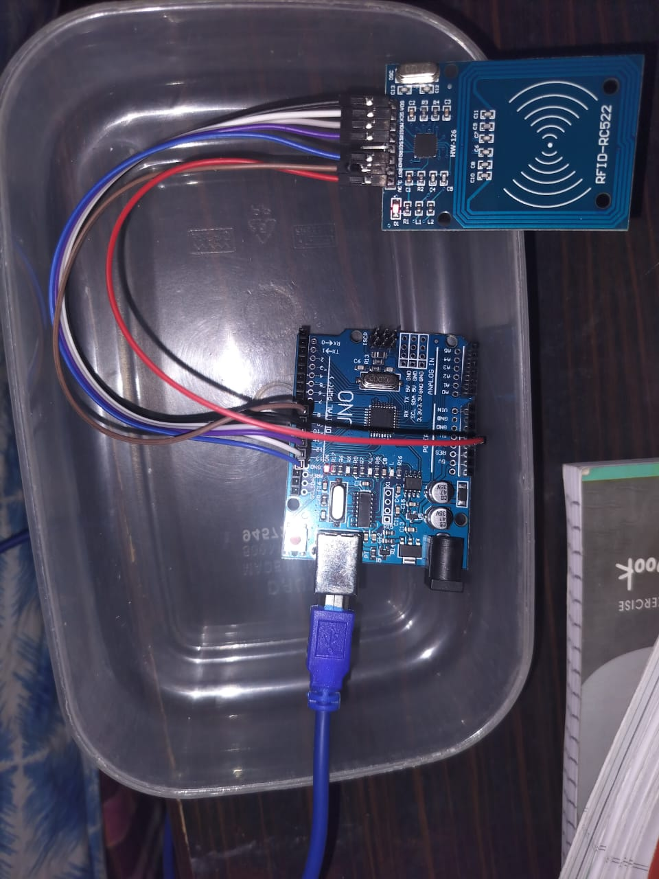
Project Prototype

Slide 11
Project Status
Github Link:
https://github.com/SakshamMohan18/Major-Project.git

Slide 12
Patent Status
Patent published

Slide 13
Research Paper Status
Presented at the International Conference on Innovative Practices in Technology and Management on 20th February, 2026

